Slide 1
Welcome to my presentation
Submitted to ;
Dr.Md Manjur Ahmed
Associate Professor
Dept.of Computer Science and Engineering
University of Barishal
Submitted by ;
Saiful Islam, Public Administration University of Barishal
EDGE Programme
Batch 21 ,Id 2

Slide 2
Company Overview BanglaTech Manufacturing Ltd. is a premier technology-driven manufacturing firm based in Bangladesh. Established in 2010, the company has rapidly evolved into a key player in the electronics and consumer goods sectors, specializing in the production of high-quality electronic components, home appliances, and consumer electronics.
Mission and Vision
Mission: To deliver innovative and superior quality products that enhance the everyday lives of consumers while fostering sustainable growth and development.
Vision: To be a global leader in the manufacturing industry, known for our commitment to excellence, innovation, and environmental stewardship.

Slide 3
Core Values
Quality: Adhering to the highest standards in every aspect of our operations.
Innovation: Continuously seeking new ways to improve our products and processes.
Sustainability: Minimizing our environmental footprint through responsible practices.
Customer Focus: Prioritizing customer satisfaction through exceptional service and product reliability.
Integrity: Conducting business with transparency and ethical practices.

Slide 4
Products and Services
BanglaTech Manufacturing Ltd. offers a diverse range of products including:
Electronic Components: Precision-engineered components for various industrial applications.
Home Appliances: High-efficiency refrigerators, washing machines, and air conditioners.
Consumer Electronics: Cutting-edge smartphones, tablets, and smart home devices.

Slide 5
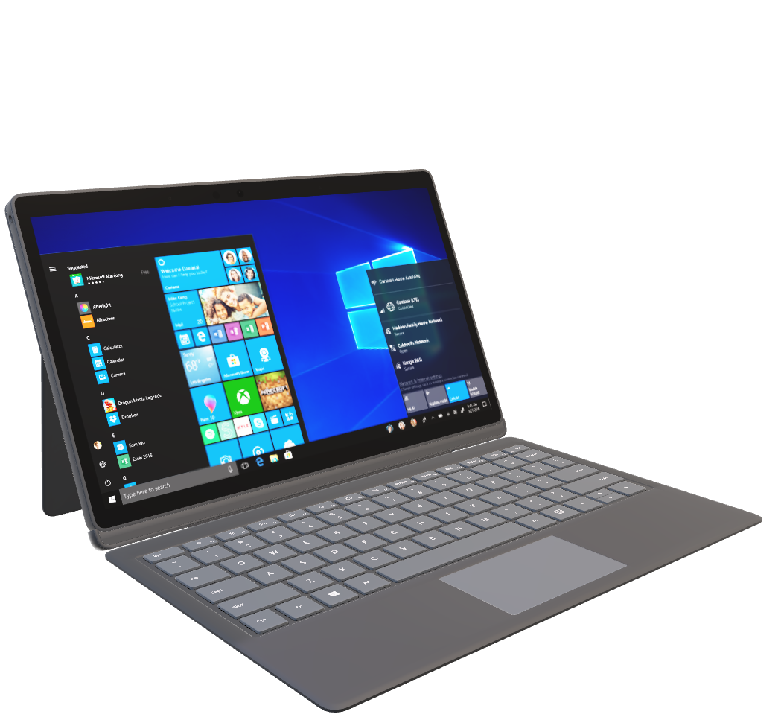

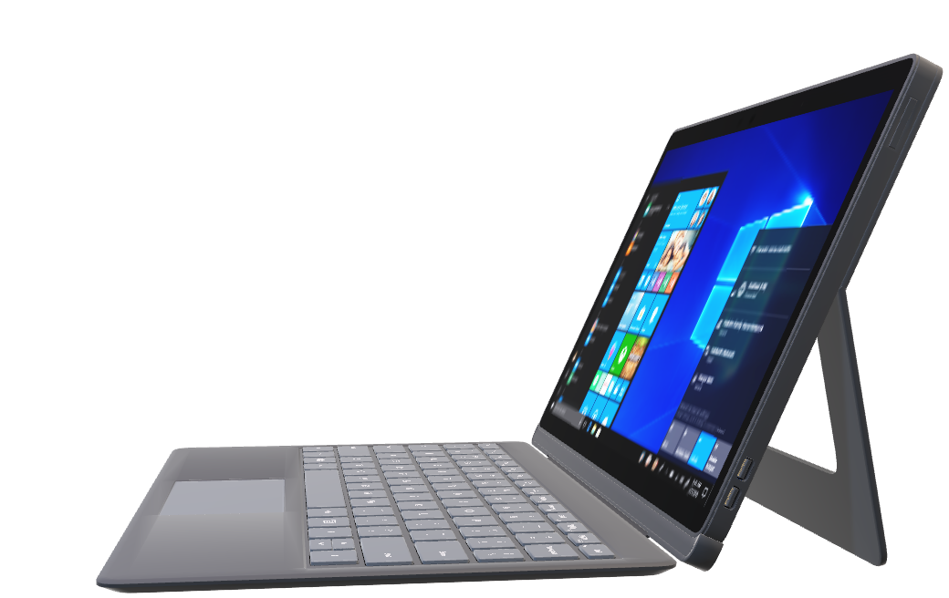
Laptops

Slide 6
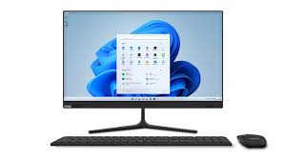
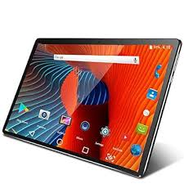
Desktops
Tablets

Slide 7

video

Slide 8

Smartphones

Slide 9
Flow Chart of Business Plan of BanglaTech Manufacturing Ltd.
Sales Strategy
Distribution and Logistics
Customer Service
Financial Planning
Market Research
Product Development
Production Planning
Marketing Strategy
Monitoring and Evaluation

Slide 10
Statistics of sold products in the last 3 months ( January – March 2024)
The sum of Total Sales (BDT)
Product | Total
Desktop | 6950000
Laptop | 12250000
Smartphone | 6150000
Tablet | 3320000
Grand Total | 28670000

Slide 11
The sum of Total Sales (BDT)
Months (Date) | Total
January | 8750000
February | 9920000
March | 10000000
Grand Total | 28670000

Slide 12
Yearly report
Month | Expenses | Sales | Profit
January | 9288500 | 8750000 | -538500
February | 9744300 | 9920000 | 175700
March | 8904700 | 10000000 | 1095300
April | 7345200 | 7957400 | 612200
May | 8987000 | 9876500 | 889500
June | 5215400 | 5164500 | -50900
July | 9976500 | 11543600 | 1567100
August | 7976700 | 8087900 | 111200
September | 9879000 | 9969800 | 90800
October | 6234800 | 7024000 | 789200
November | 4534800 | 4809300 | 274500
December | 8348700 | 8834800 | 486100

Slide 14
THANKS TO ALL

